Slide 1
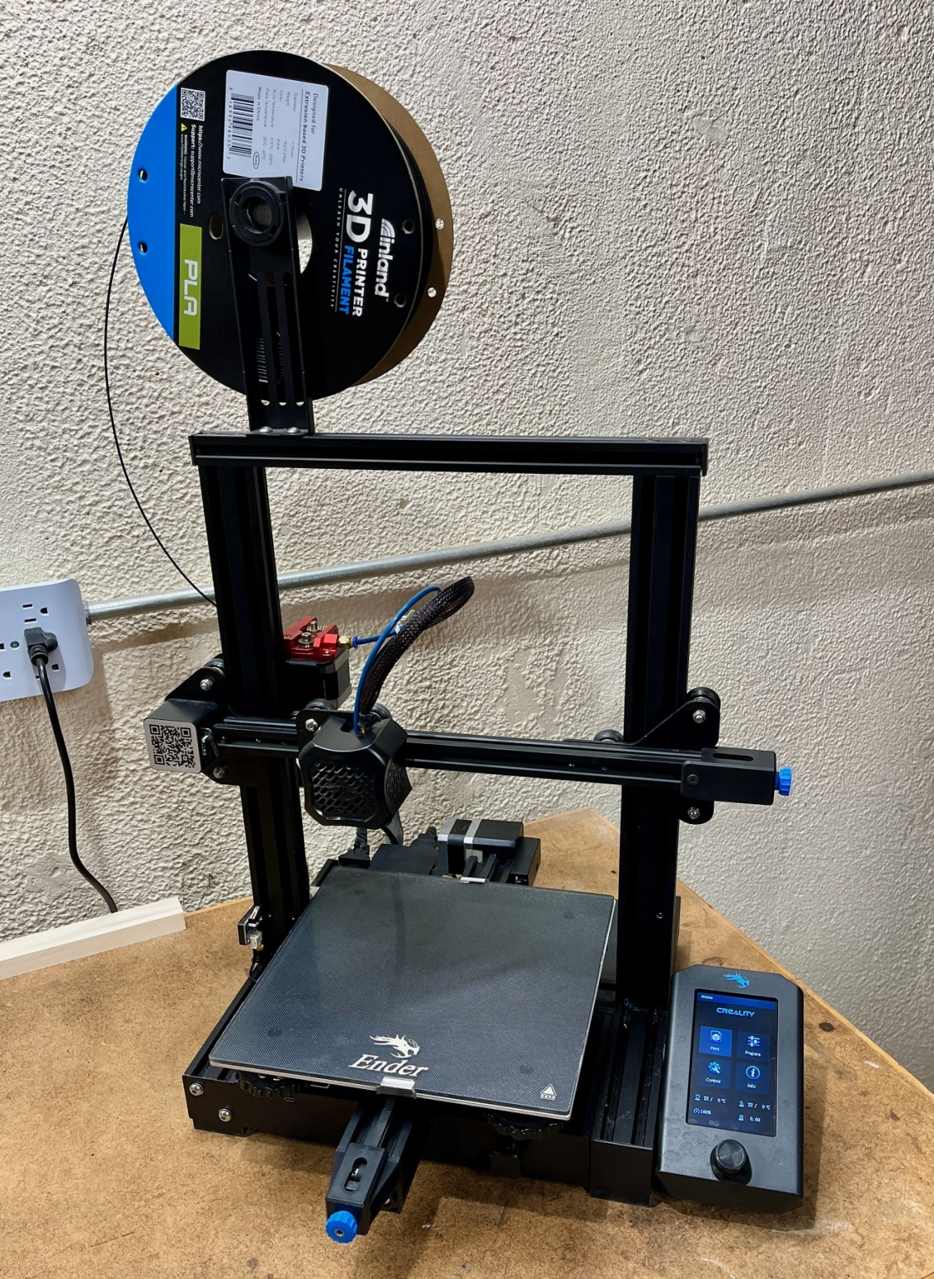
The Magic of the 3D Printer

Slide 2
Creates Parts by extruding successive layers of plastic material
Virtually any complexity
Enclosed hollows are possible

Slide 3
Evolution of the 3D Printer
- First ultra violet sintering of photoreactive polymer.
1987 - Stratasys patents FDM (Fusion Deposition Method)
- Stratasys patent expires. Reprap & Makerbot forge the DIY market.
2019 - Over 170 companies making 3D Printers.

Slide 4
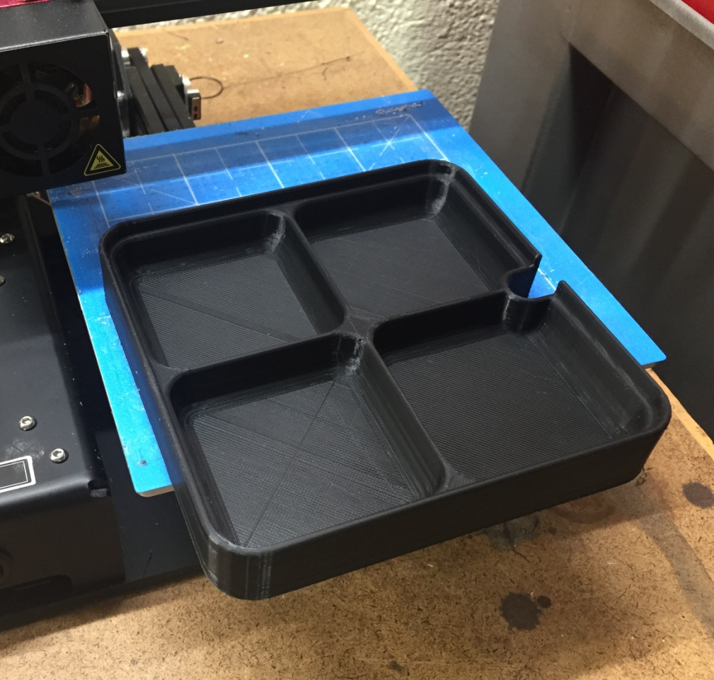
Examples: Functional Pieces
Parts Tray
Star Light Holder
Offset Duct Connector

Slide 5
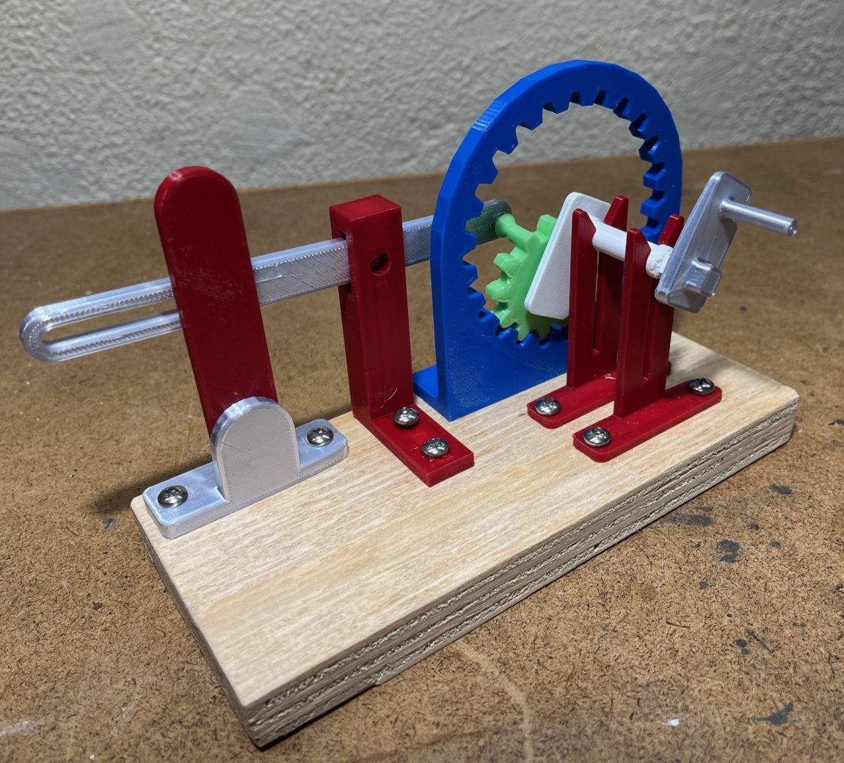
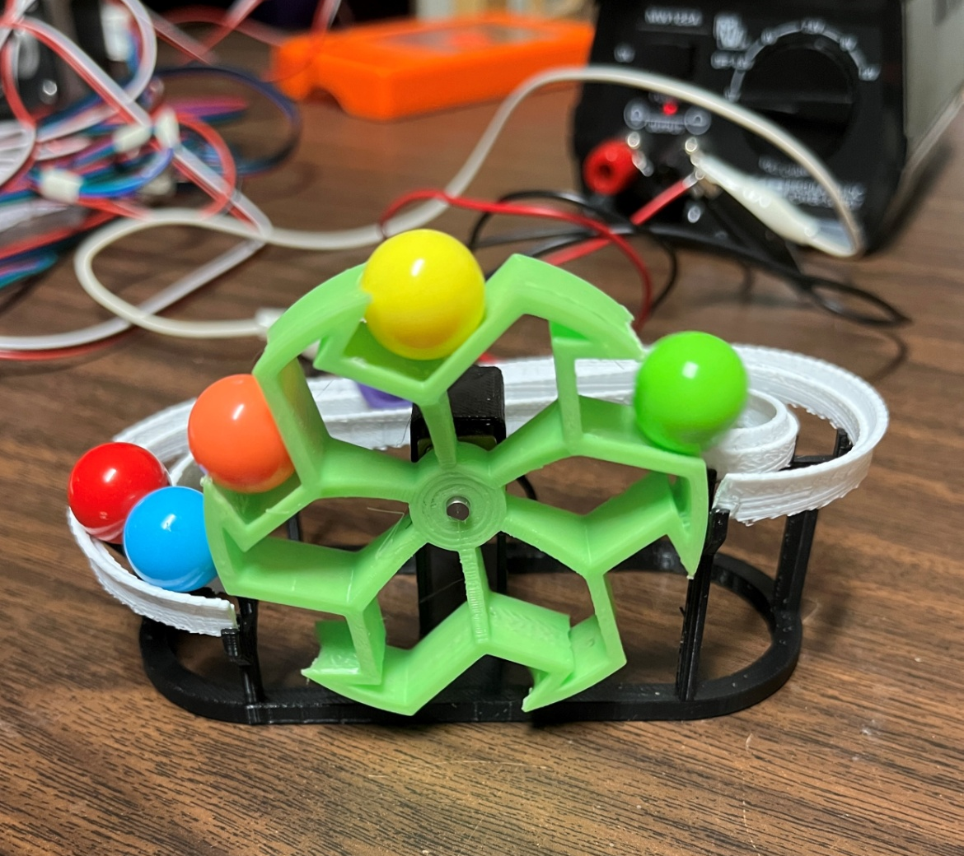
Examples: Fun Things
Oscillating Lever
Continuous Circulating Balls

Slide 6
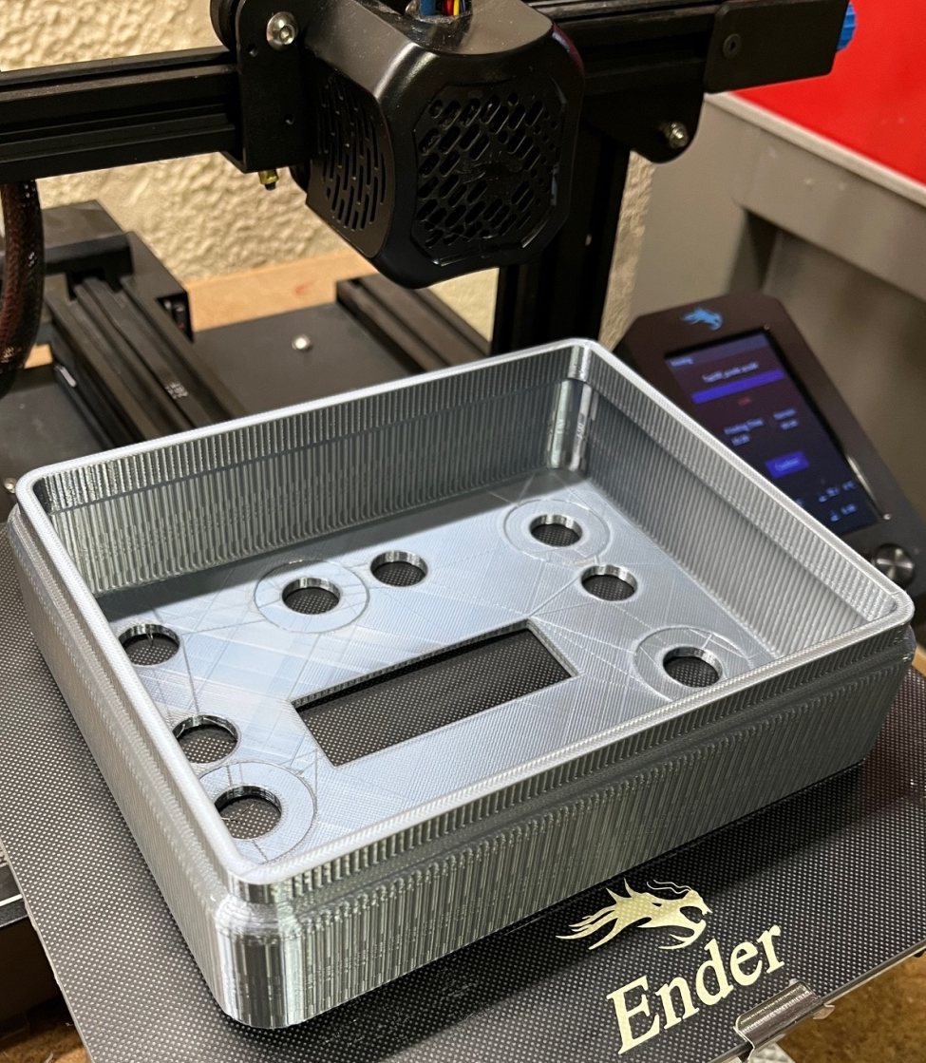
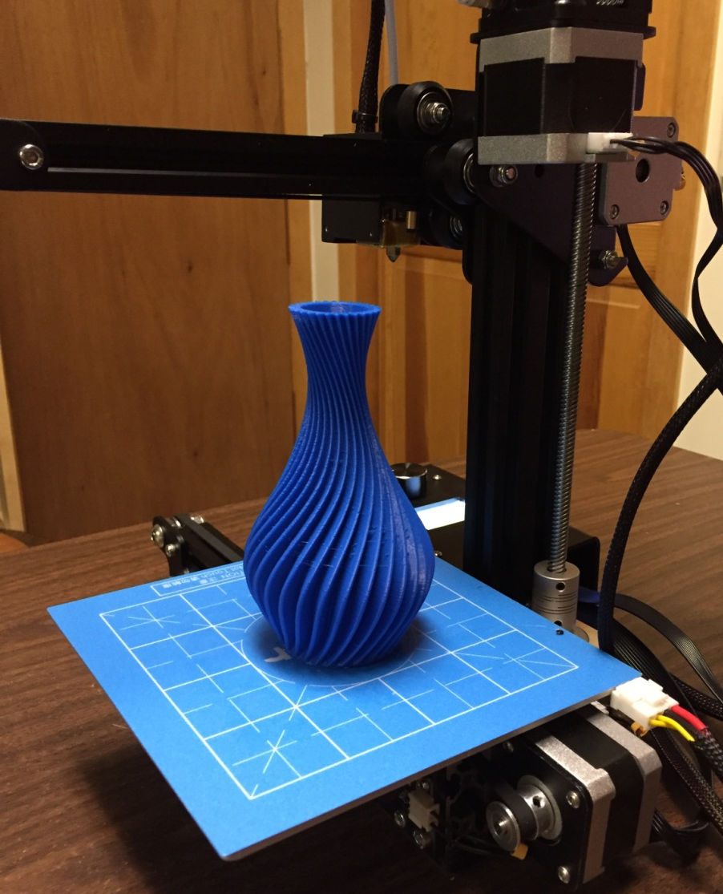
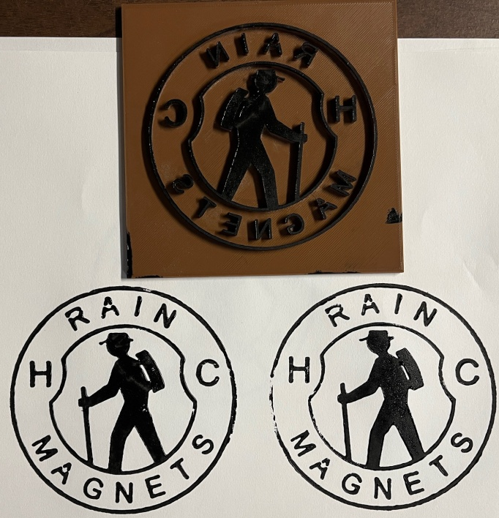
Examples: Odds & Ends
Spiral Vase
Enclosures
Ink Stamps

Slide 7
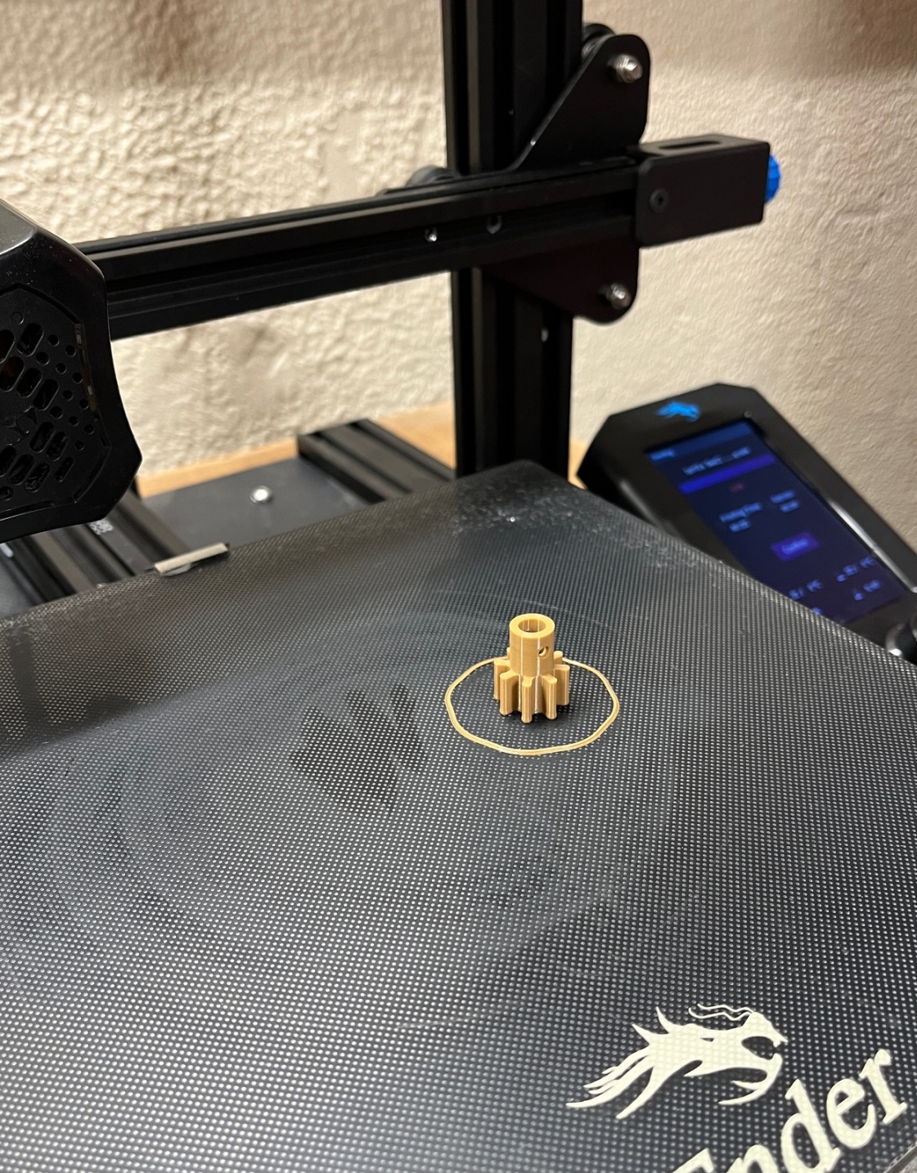
Examples: Small Pieces
Specialty Gear
Pottery Stamps
Parts

Slide 8
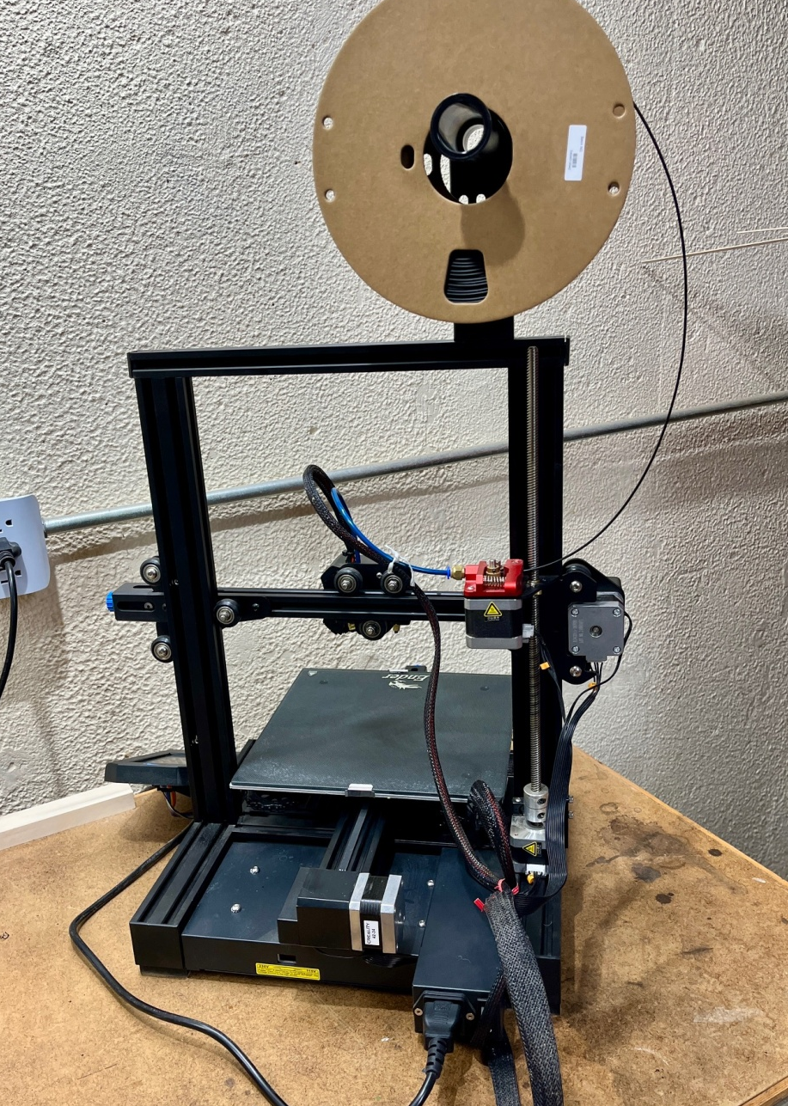
The 3 D Printer: Creality Ender 3 V2
FRONT
BACK

Slide 9
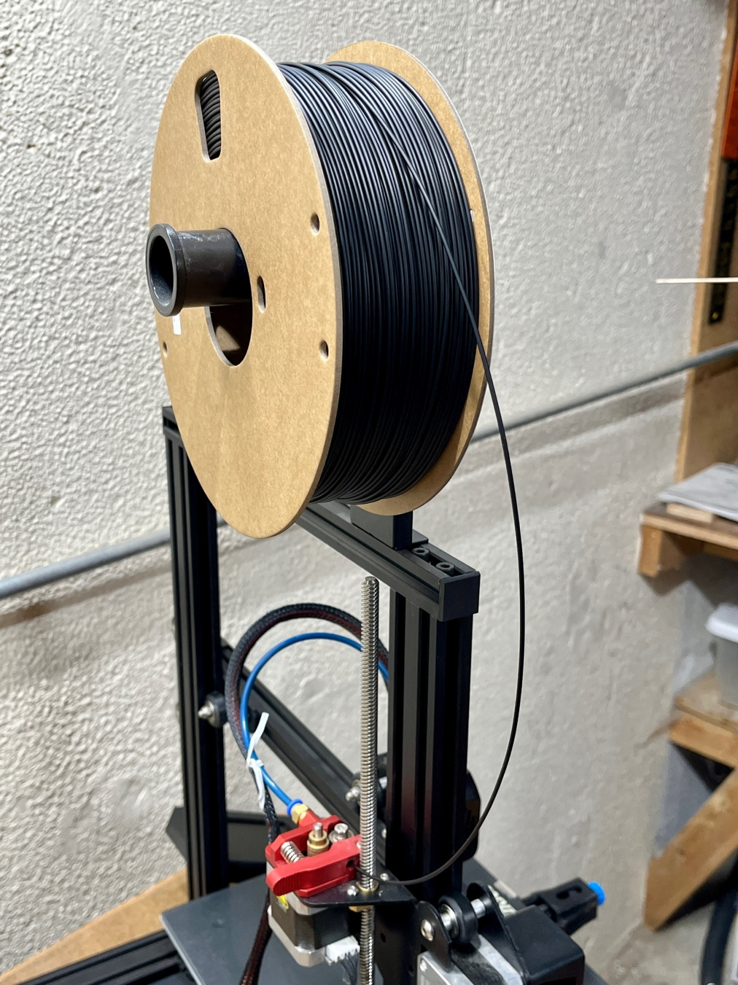
Filament

Slide 10
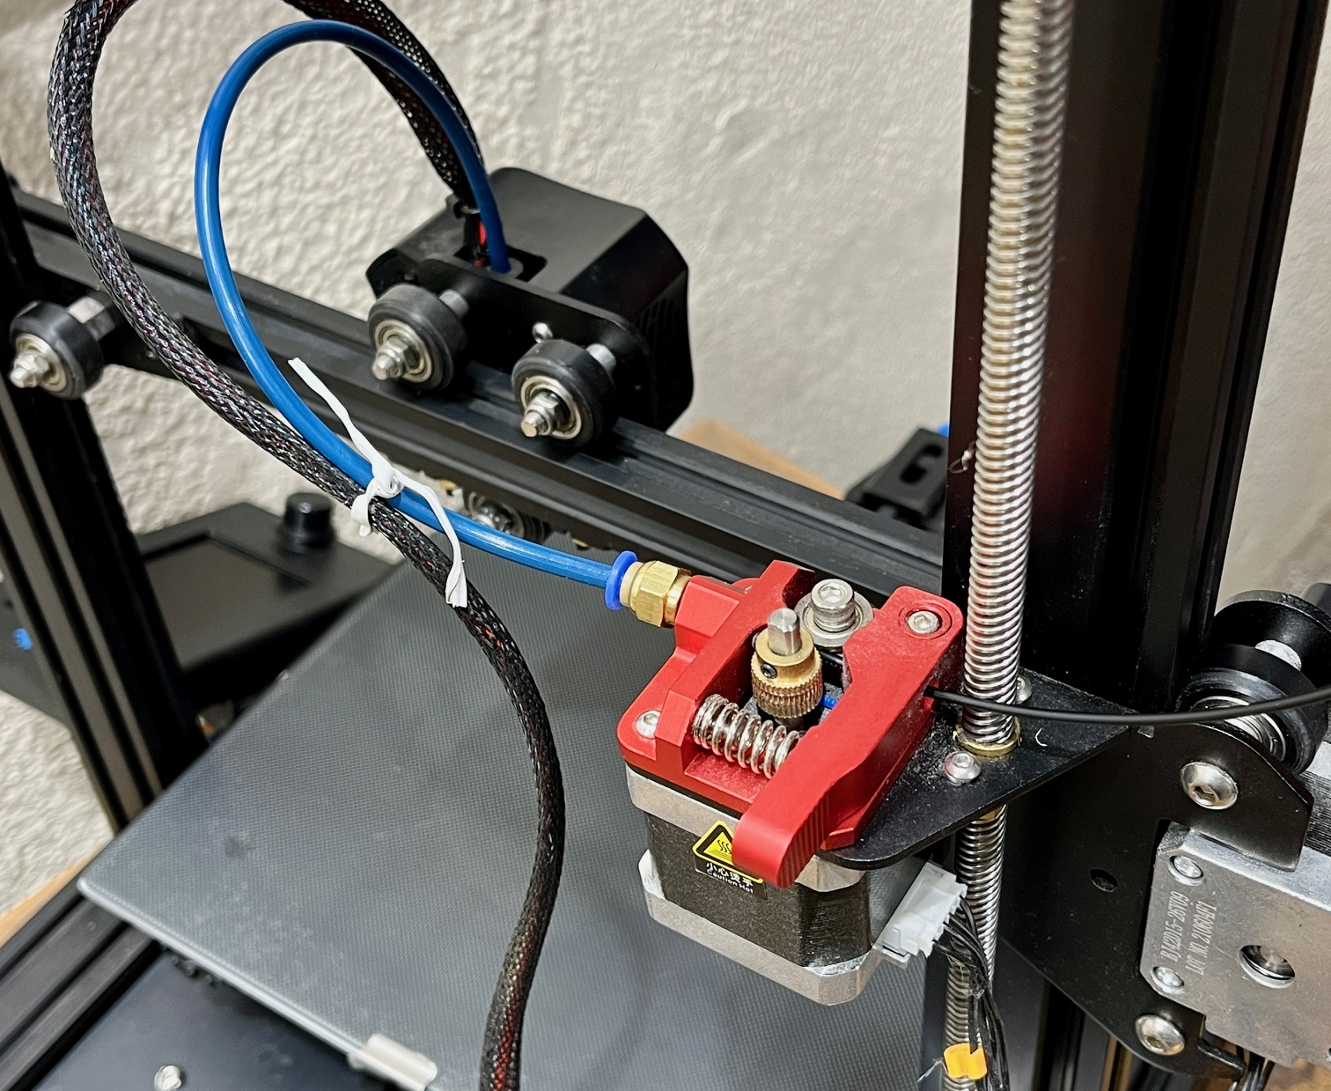
Filament Feeder

Slide 11
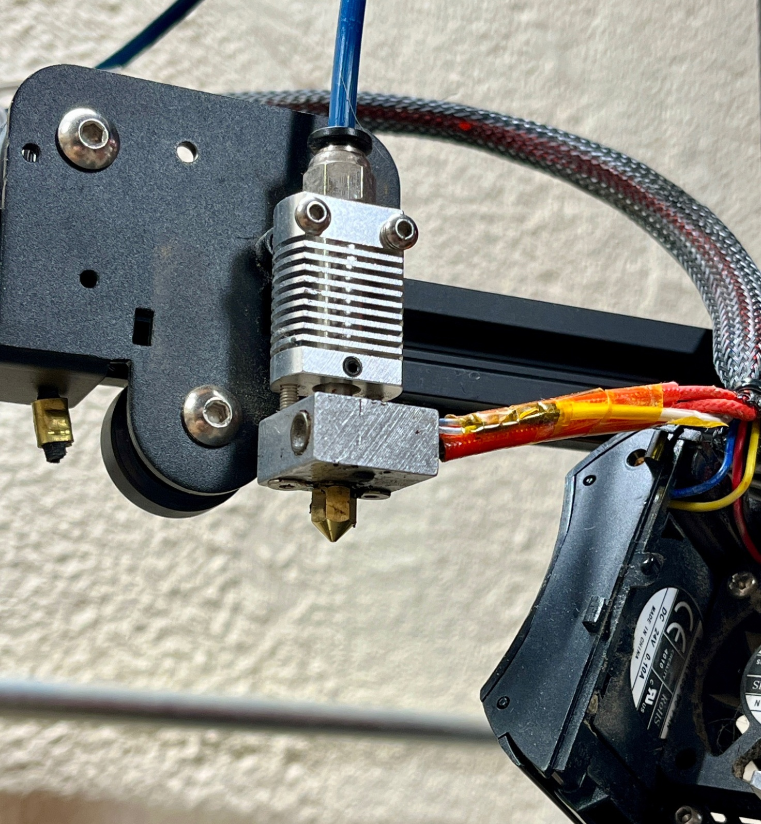
Hot End

Slide 12
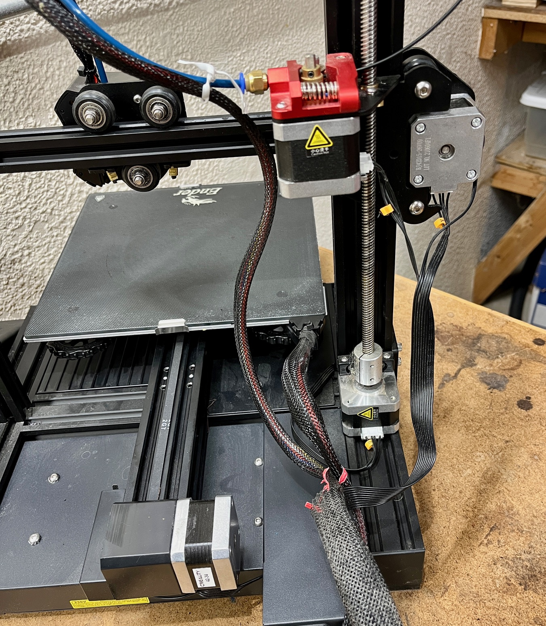
Axis of Motion & Build Plate

Slide 13
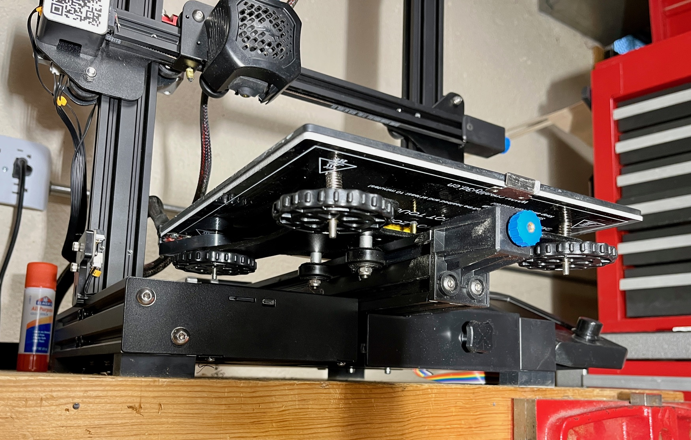
Build Plate Leveling

Slide 14
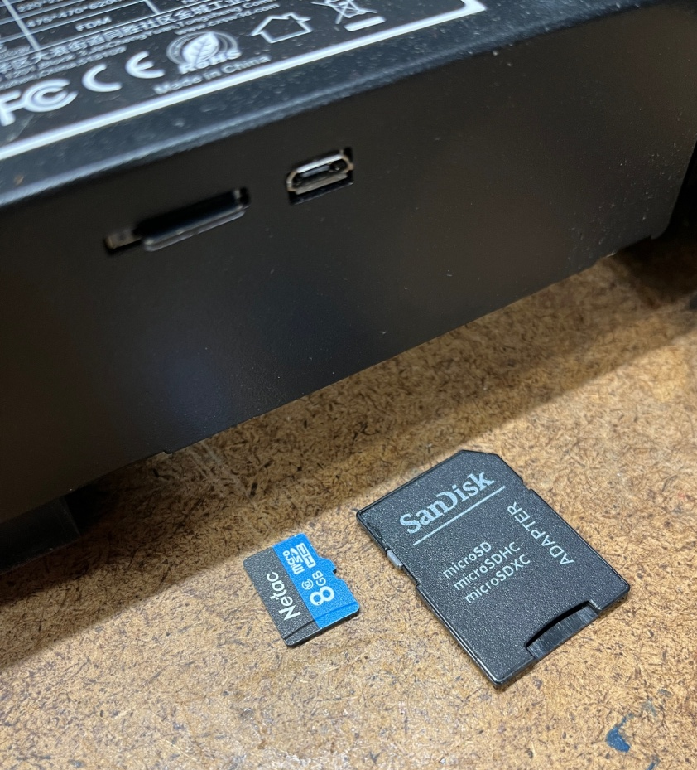
Procedure to Print
1. Design part in CAD (either solids or surfaces).
Save as an .stl file.
Input to Slicer program.
Slice in layers and review.
Save on an SDmicro card, as a gcode file.
Place card into 3D Printer and select file to print.

Slide 15
Printing Materials (Filaments)
PLA (Poly Lactate Acid) - Most Commonly Used:
A thermoplastic polyester.
Made from plant material, not petroleum oil.
From Starch, from corn, sugar beets, and sugar cane.
Hard, strong, brittle but not fragile.
Water soluble over long exposure times.
Many Colors.
ABS and PETG: Other Commonly Used
Nylon and TPU: Less Commonly Used:

Slide 16
Print Variables (many others)
Extruding Layer Height - typical .2 mm~.008”
Wall Thickness - typical 1mm ~ .040”
Filler Between Walls - typical 20%
Accuracy - within a few thousandths
Shrinkage - relatively minimal

Slide 17
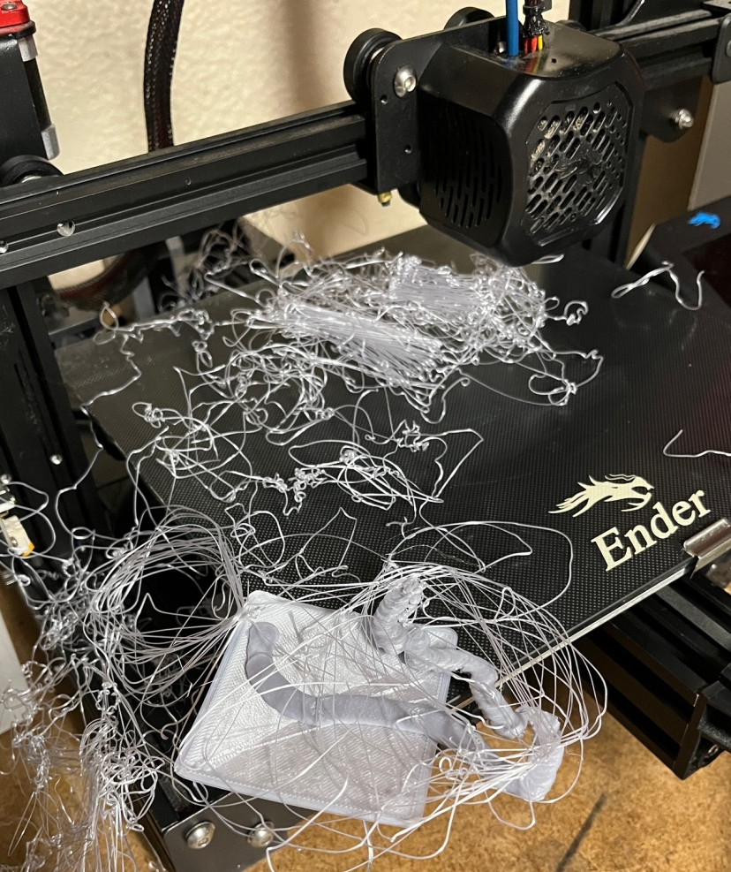
Potential Problems
Need for Support (use Supports in slicer)
PLA Filament - Moisture Absorption (Heat filament 6 hr at 130 def F)
Adhesion to Build Plate (use glue stick)

